Slide 1



.
CS 112 – Foundations of
Computer Science
Dr. Adriano Cavalcanti
PhD MABE, MS EE, BSc CSc
Computational Nanotechnology & Biomed Robotics
Office location: Hebeler 107 - Phone 509-963-2063
Email: adriano.cavalcanti@cwu.edu
Office hours:
Mon Tue Wed 2:00pm-3:00pm; Or by appointment

Slide 2





CSE A205 Introduction to C Programming for Engineers
Dr. Cavalcanti
a/k/a Dr. Color Candy or Dr. C

Slide 3







Election Program
Notes:
3

Slide 4






Election Program
Notes:
4

Slide 5


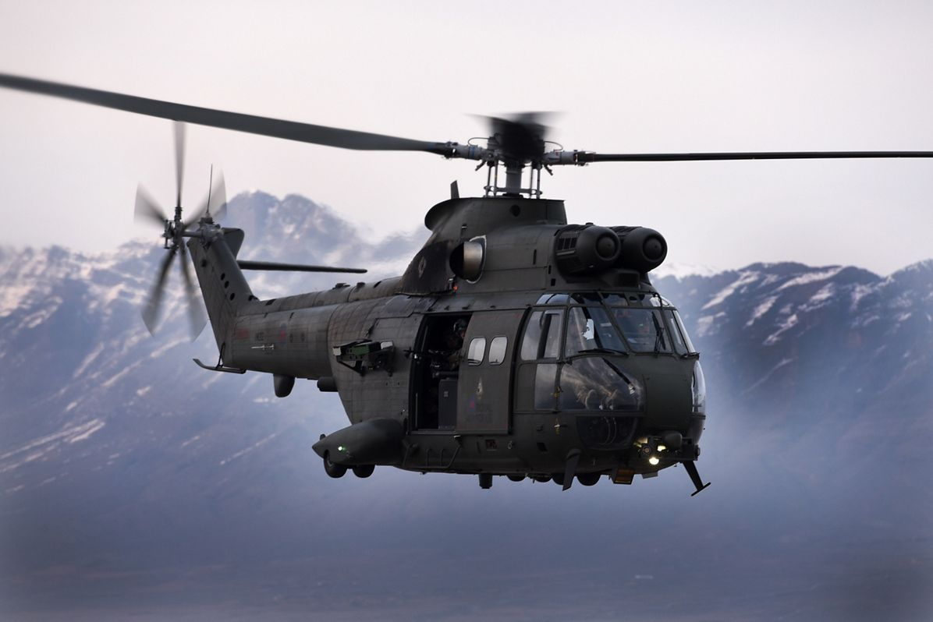
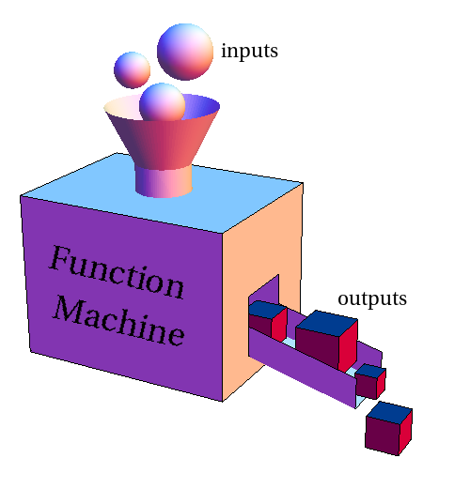
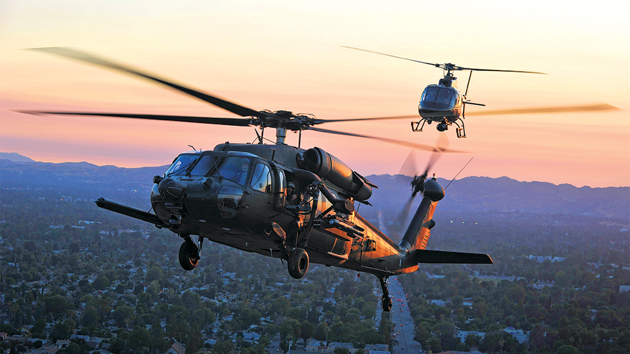


Election Program
Create a class HelicopterData as your data structure
HelicopterData
visibility
fuel
Notes:
5

Slide 6

Election Program
Create a class Flying with methods
Flying
API
enter_data
fly_helicopter
Notes:
6

Slide 7
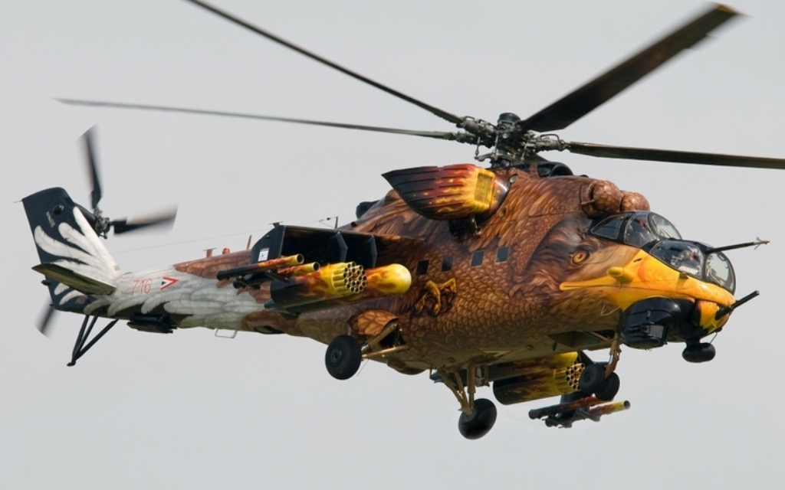
Election Program
Write a small program to simulate a helicopter flying; the class Flying has the methods API, enter_data, fly_helicopter:
method API calls the method enter_data.
Method enter_data asks the user how many helicopters are flying, to create an array of objects class HelicopterData helicopter; helicopter containing the variables fuel and visibility; Method enter_data also asks for the fuel and what is the current visibility for each helicopter; then enter_data returns the array of helicopter to the method API;
method API calls the method fly_helicopter, sending the array of helicopter to fly_helicopter;
Inside fly_helicopter, check for each helicopter: if the visibility is smaller than 60% don’t fly and print the message “not safe to fly”; otherwise keep flying until the fuel is larger than 10%; every loop subtract 2% from the fuel and print the message, e.g.: “flying… now with fuel 30%” showing the value of the variable fuel; when fuel get smaller than 10% print the message “low fuel 9% landing now” and finish the program.
Notes:
7

Slide 8

Dr. Cavalcanti
a/k/a Dr. Color Candy or Dr. C

